Slide 1
CIS 5200:Systems Analysis and Design Building & Safety Permit Submitted to Dr. Jongwook Woo
Submitted by: Bhagyashree Jadhav
Mittal Vaghela
Narendra Mali
California State University, Los Angeles

Slide 2
Table of Content
About Project
What have we used
Hive Queries
Graphs and Final Results
Conclusion

Slide 3
About project
Data analysis is done on Building and Safety Permit Information for the City of Los Angeles.
Data analysis is done using IBM Bluemix, HiveQL.
Analyzed data is visualized using Tableau, Google Fusion Table, PowerView, 3D Map In Excel in the form of Charts, Graphs and Maps.
Data Size
206 MB

Slide 4
Types of Permits
Permits are categorized into
Building Permits
Electrical Permits
Mechanical Permits
These permits are categorized into sub permit types such as
Fire Sprinkler
Swimming-Pool/Spa
Commercial

Slide 5
Big Data Life-Cycle
Capture Data
Visualize Data
Process Data
Analyze Data
Store Data

Slide 6
Flow Chart
Raw Data
In .CSV
Upload Data in Dropbox
Create Hive Tables
Visualization of Data
Loading Analyzed Data to Excel from BigInsight
Create Hive Queries

Slide 7




What Have We Used
BigInsight
Tableau
PowerView in Excel
Google Fusion Table
3D Map in Excel

Slide 8
Data Analysis
Data Analysis is Done On..
Permit
Permit Sub-Type
Permit Category
Contractor's Business Name
Permit Status
Issue Date of the Permit.
License Expiration Date
Valuation
State
City
License Type

Slide 9
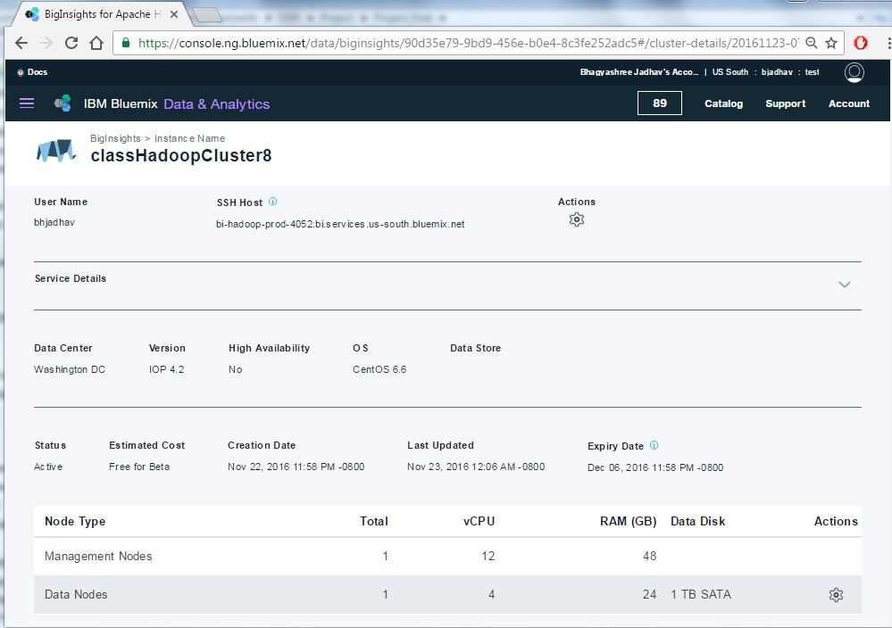
Details

Slide 10
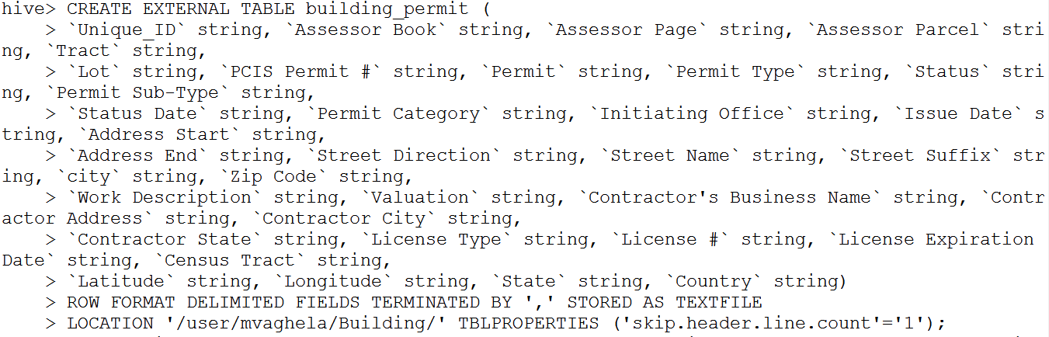
Query 1- Loading Data to Table

Slide 11
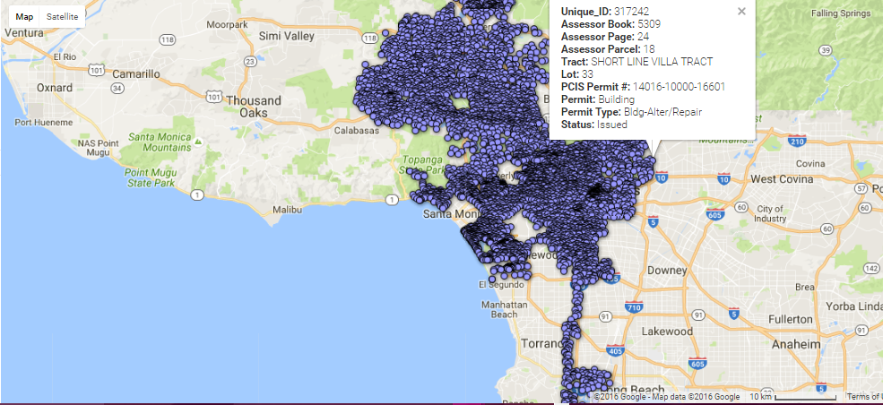
Raw Data Output using Google Fusion Table

Slide 12

Query 2 – Permit Sub-type
Query to Find Count of Permits by Permit Sub-Type

Slide 13
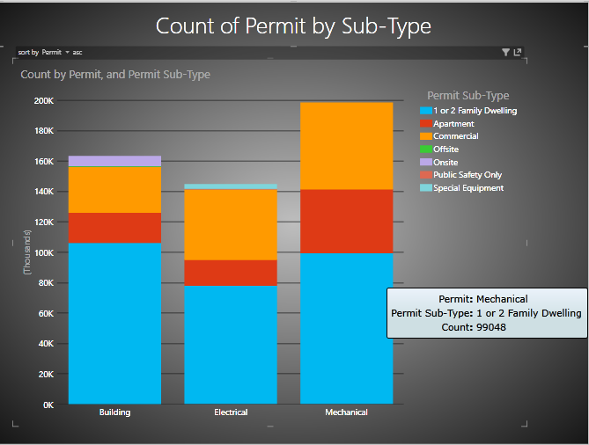
Output of Query 2 using Excel Power View

Slide 14

Query 3 – Permit Category
Query to find number of permits by Plan Check or No Plan Check

Slide 15
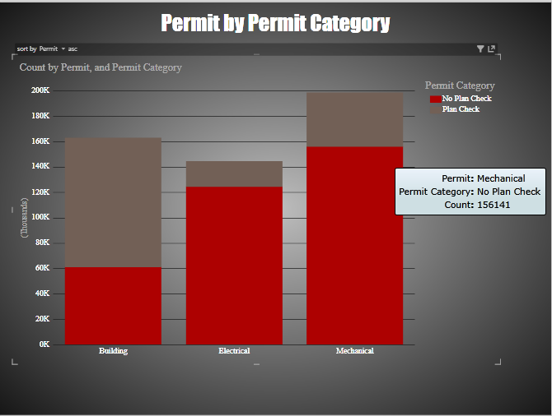
Output of Query 3 Using Excel Power View

Slide 16

Query 4 – Display Permits
Query to find number of permits by City and Permit Subtype

Slide 17
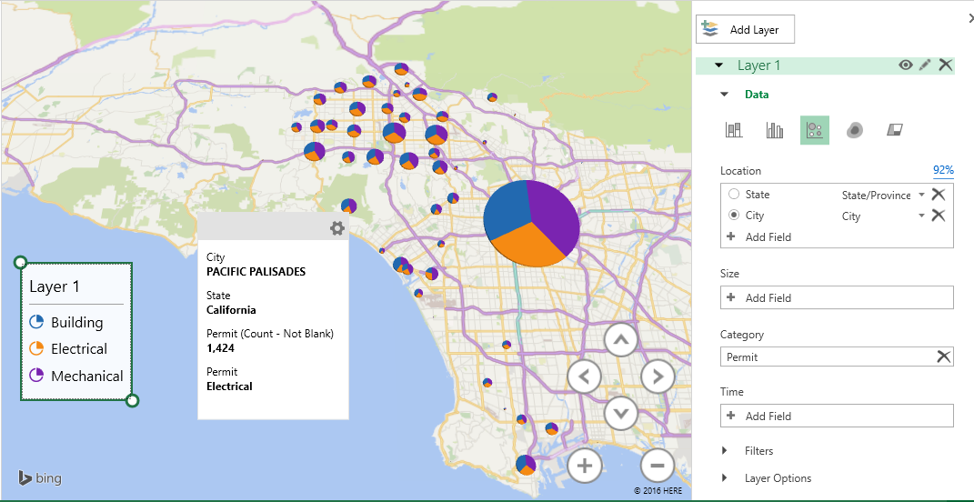
Output-1 of Query 4 using Excel 3D Map

Slide 18
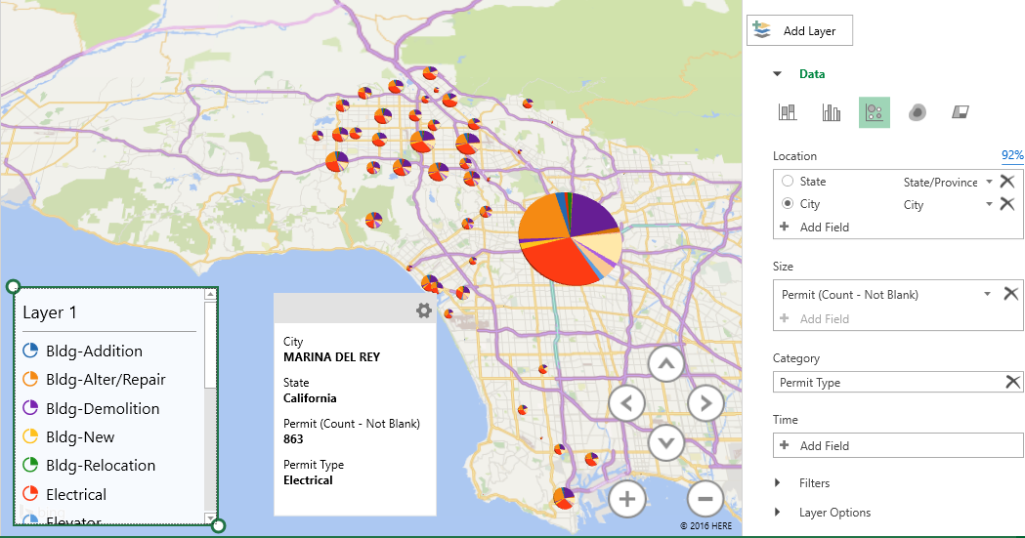
Output-2 of Query 4

Slide 19

Query 5 – Valuation of Permits
Query to find average valuation of different types of Permits

Slide 20
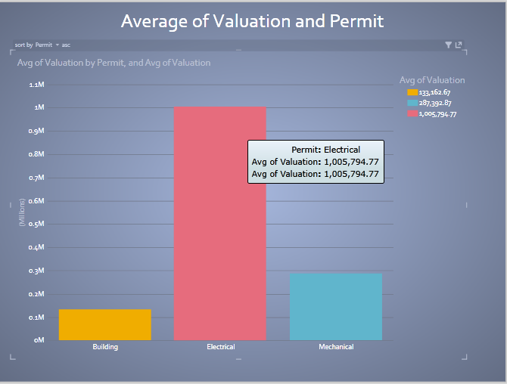
Output of Query 5 using Excel Power View

Slide 21
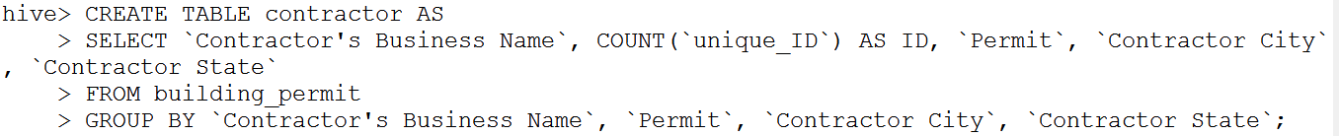
Query 6 – Contractor's Business Name
Query to find Contractor's Business Name by number of permits and their location

Slide 22
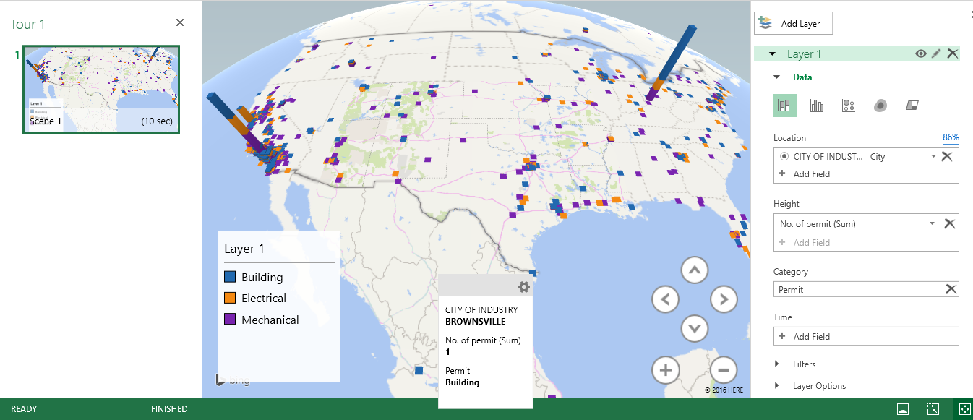
Output of Query 6 using 3D Map

Slide 23

Query 7 – Status
Query to find number of permits by their status

Slide 24
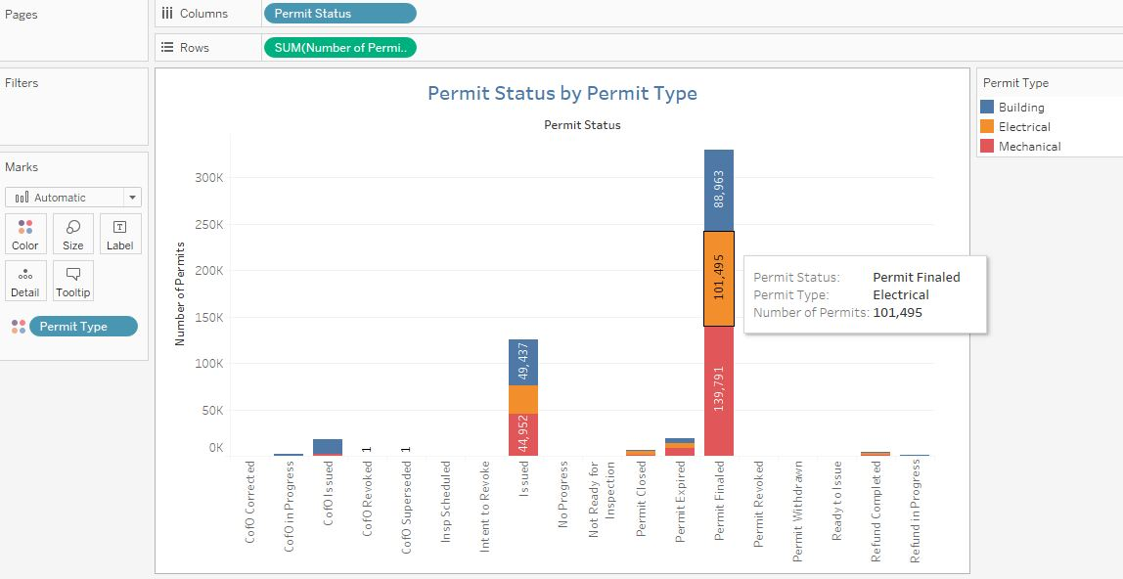
Output of Query 7 using Tableau

Slide 25

Query 8 – Permit Issue Date
Query to find number of permits issued in particular year

Slide 26
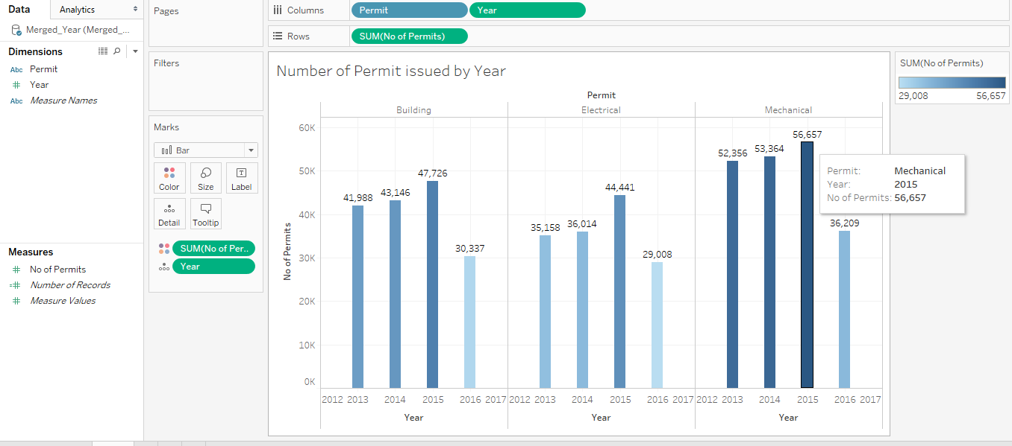
Output of Query 8 using Tableau

Slide 27
License Types
B: General building.
C-10: Electrical
C-16: Fire Protection
C-20: Warm-Air heating, ventilating and Air-Conditioning
C-39: Roofing
C-46: Solar Contractor
C-53: Swimming Pool

Slide 28

Query 9 – License Type
Query to find count of License Type by it’s average valuation

Slide 29
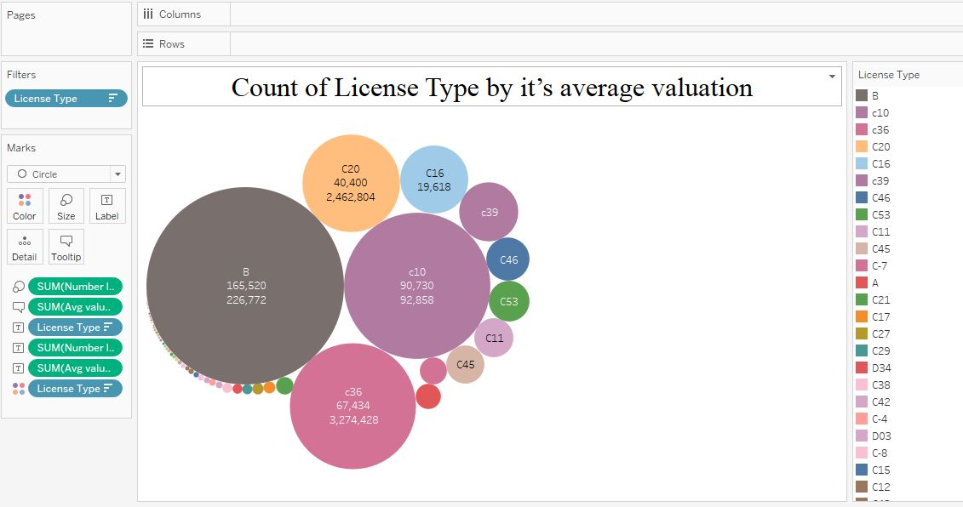
Output of Query 9 using Tableau

Slide 30
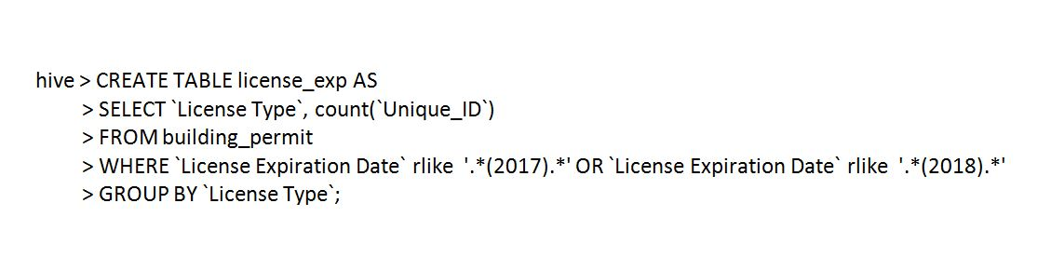
Query 10 – License Expiration Date
Query to find number of license types by it’s expiration date

Slide 31
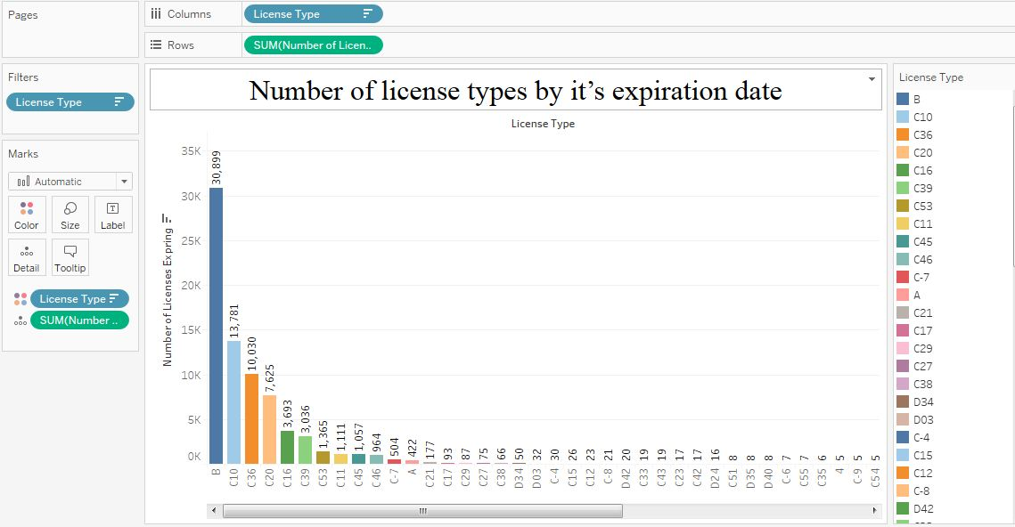
Output of Query 10 using Tableau

Slide 32
Conclusion
Every year highest number of Permits have been issued for Mechanical Permit type since year 2013.
97% of the Contractors are California residents.
Most of the demolition work is being done in LA Downtown Area hence future construction possibility increases in that area.
Percentage increase is highest in Electrical Permit category when compared to previous year.
Maximum number of ‘General Building’ type of licenses are going to expire in next two years.

Slide 33
References
https://www.lacity.org/
http://www.tutorialspoint.com/hive/hive_data_types.htm
https://docs.treasuredata.com/articles/hive
http://www.cslb.ca.gov/Resources/GuidesAndPublications/DescriptionOfClassifications.pdf
http://www.tableau.com/learn/training

Slide 34
LINKS
GITHUB Link: (Code Only)
https://github.com/narendramali1/CIS5200
Presentation Slideshare Link:
Dataset Link: (Datasize – 206 MB)
https://data.lacity.org/A-Prosperous-City/Building-and-Safety-Permit-Information/yv23-pmwf

Slide 35
Thank You
Q & A

